Slide 1
Programming Techniques
Project Requirement
Example Scenario
(Page 7 in project document)

Slide 2
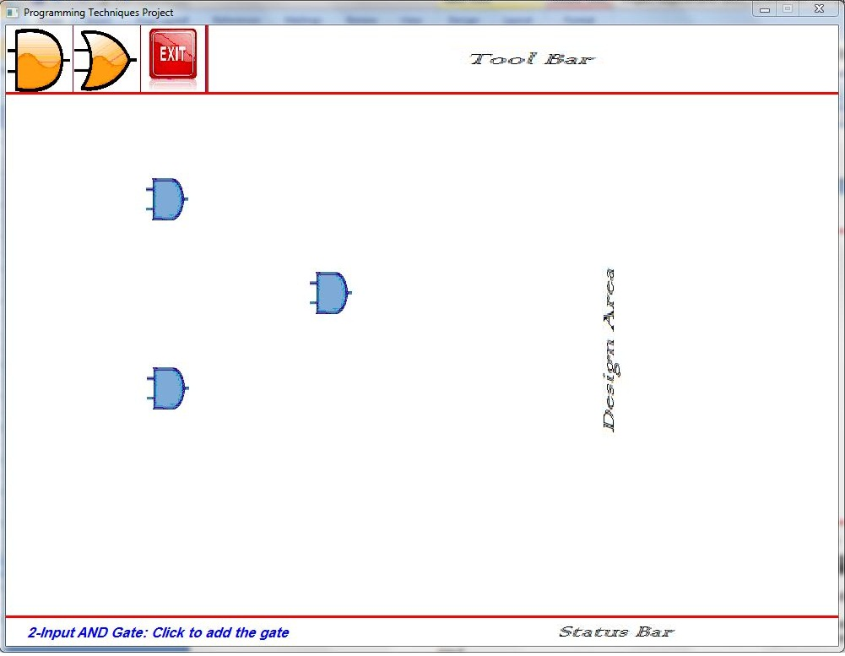
Drawing 2-input AND gate
User Perspective
Application is waiting for user action
User clicks on AND2 icon
Message appears on status bar
User selects a point to draw at
Component is drawn

Slide 3
Steps to execute ANY operation
Program Perspective
4 basic steps to execute any operation:
Step I: Get User Input & Map to Action Name
Step II: Create Corresponding Action Object
Step III: Execute the Created Action
Now Action is complete but not reflected yet to interface
Step IV: Update Interface

Slide 4
Drawing 2-input AND gate Operation
Program Perspective
Step I: Get User Input & Map to Action Name
  User clicks on AND2 icon in menu
  Input class maps it to ADD_AND_GATE_2 action (enum)
Step II: Create Corresponding Action Object
  Create Object of class AddANDgate2 Action
Step III: Execute the Created action
  Ask user to click where he needs new AND gate to be drawn
  Create Object of AND2 Component
  Add AND2 object to the list of Components
Step IV: Update Interface
  For each component in the list, call Draw function
  Each Component calls the appropriate draw function from Output class

Slide 5
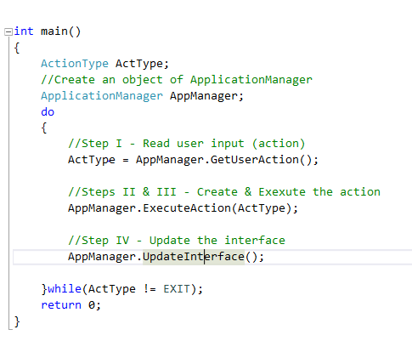
Step I: Get user input

Slide 6

Step I: Get user input
ActionType:
ADD_AND_GATE_2
6
Main
Application Manager
AppManager->GetUserAction();
1
5
ActionType:
ADD_AND_GATE_2
2
pIn->GetUserAction()
Click AND2 icon
3
WaitMouseClick()
Input
Area Checking &
Action Recognition
4
(x, y)
Click Position

Slide 7
Step II: Create a suitable action
Step III: Execute the action

Slide 8
Step II: Create corresponding action
1
AppManager.ExecuteAction(ADD_AND_GATE_2);
Main
Application Manager
3
pAct->Execute();
//Action::Execute
//is a pure virtual fn.
Action* pAct = NULL; //polymorphism
//switch-case ➔ create the action
pAct = new AddANDgate2(this);
AddANDgate2
Action
(derived class)
2

Slide 9

Step III: Execute the action (1/2)
AddANDgate2::ReadActionParameters()
pOut->PrintMessage(message);
//to print message on status bar
AddANDgate2
Action
(derived class)
1
Output
2
Print message on status bar:
…….. click to add the gate
3
pIn->GetPointClicked();
6
(a, b)
4
WaitMouseClick(x, y)
Input
User clicks at required
gate location say(a,b)
(a, b)
Gate Position
5

Slide 10
Step III: Execute the action (2/2)
AddANDgate2::Execute()
2
pManager-> AddComponent(pCmp)
//ask the App. manager to add the gate
to the list of Components CompList
//polymorphism: Component * CompList[MaxCount];
Application Manager
CompList[ ]
AddANDgate2
Action
(derived class)
//Create AND2 Component
//calculate Component GfxInfo from clicked (a,b)
pA = new AND2(GfxInfo, AND2_FANOUT);
Component
Component *
Component *
Component *
Component *
Component *
Component *
1
AND2
Component
(derived class)

Slide 11
Step IV: Reflect the action to the Interface

Slide 12
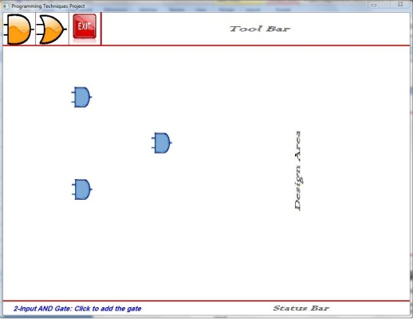
Step IV: Reflect the action to the Interface
Main
1
AppManager.UpdateInterface();
Application Manager
CompList [ ]
2
Component *
Component *
Component *
Component *
Component *
Component *
Component *
AND2
Component
(derived class)
3
pOut->DrawAND2(…);
Output
AND2
Component
is drawn
For each comp. in the list
CompList[i]->Draw(pOut);
//Component::Draw()
//is a pure virtual fn.
2
4

Slide 13
Thank You ☺

